Slide 1
PSYC003: Psychological Influences on Health & Behaviour
Stress & Coping
School of Psychology, University of Plymouth
Dr Rob Heirene
March 2023
Notes:
https://www.mentimeter.com/app/presentation/72f675641dcbe6f29c4ec518e0b39be9/aca57dafc305/edit

Slide 2

About me
Name: Dr Rob Heirene
Office: A210 Portland Square
Email: Rob.Heirene@Plymouth.ac.uk

Slide 3


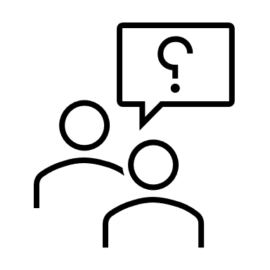

About today’s class
Block 1
Stress & illness
Stress as a stimulus
Stress as an interaction between event & individual
Stress as a physiological response
Stress & health
Interactive task: How do we cope with stress?
~10-minute break
Block 2
Coping & illness moderators
What is coping?
Personality
Interactive task: How do we compare to research findings (optimism)?
Locus of control
Social support
Cross-cultural differences
~5-minute quest-
ion time
Notes:
Slide errors!

Slide 4
Block 1 Stress & Illness

Slide 5


Stress & illness
Typically studied & conceptualized in three ways:
As a stimulus or event external to the individual
As an interaction between a stimulus event & the cognitive & emotional characteristics of the individual
As a physiological reaction
Notes:
Some days we all feel a bit like this (first picture)
Or this (the second picture)
Stress is extremely widespread and commonly known phenomenon, we all know, it, we all recognise it, we all hate it and yet it’s very difficult to define.
When we ask people to define what they mean by stress we often get very different and varied responses
In the psychology literature with typically conceptualise it in one of three ways which we will critically discuss in the next sections of the lecture

Slide 6
Stress & illness Stress as a stimulus
Stress can be considered as the response to an event or events
Life events theory (Holmes & Rahe, 1967):
Various life events disrupt our lives in some way (i.e., they are stressful)
Social readjustment: The intensity & length of time necessary to accommodate a life event, regardless of the desirability of the event
Life events have a cumulative effect on stress levels
Key tenets of this approach
Events can be objectively labelled & measured (e.g., retiring)
Components can be measured (e.g., proximity to event)
Can include seemingly negative (e.g., divorce) and positive (e.g., marriage) events.
Often involves studying catastrophic events (e.g., 9/11, natural disasters) & major life events (e.g., new job, holidays)
Notes:
Some researchers focus on stressful events themselves and on the external environment’
That is, people will attribute their tension to an event or events such as moving house or getting married
[DISCUSS TEXT BOX POINTS]
Holmes & Rahe, 1967: The main proponents of this approach are X & X. They proposed a “Life events theory” in 1967
- Very influential - this has over 20,000 citations now!
Proposed that there are a variety of life events, whether positive or negative, desirable or undesirable, that impact our life in such a way that we need to adjust our lives to accommodate them; they’re disruptive
In this sense, they are stressful life events
They use this term social readjustment to refer to the process of dealing with these life events
And they also proposed that these life events don’t have an isolated impact on our stress levels and health
The more life events we experience within a period, say a year, the greater the likelihood of physical health problems
Makes sense! Moving with kids to a new place for a new job, new social situations.
Assignments, plus being unwell, plus personal issues/job issues

Slide 7
Representative life event items from the Social Readjustment Rating Scale (Holmes & Rahe, 1967)
Event | LCU rating (1-100)
Death of a spouse | 100
Divorce | 75
Death of a close family member | 63
Personal injury or illness | 53
Marriage | 50
Being fired from work | 47
Retirement | 45
Major change in the health or behaviour of a family member | 44
Pregnancy | 40
Sex difficulties | 39
Death of a close friend | 37
Change to a different job | 36
Foreclosure of mortgage or loan | 30
Son or daughter leaving home | 29
In-law troubles | 29
Outstanding personal achievement | 28
Begin or end formal schooling | 26
Troubles with the boss | 23
Change in social activities (clubs, movies, visting etc.) | 18
Vacations | 13
Christmas | 12
Stress & illness Stress as a stimulus
Social Readjustment Rating Scale (Holmes & Rahe, 1967)
Do these events resonate with your sense of stressful life events?
How applicable are they today?
Notes:
Score of 300+: At risk of illness.; Score of 150-299: Risk of illness is moderate (reduced by 30% from the above risk).; Score <150: Only have a slight risk of illness.
To make these claims, Holms and Rahe carried out a series of studies:
first, they invited over 5000 people to generate a list of events they found most stressful
They use this to generate a list of 43 commonly mentioned events, including positive and negative and frequent and rare events
They then asked a new sample of nearly 400 people to rank the listed events in order of the degree of disruption the event, if experienced, had caused them
They also asked these participants to rate each event against marriage, which had arbitrarily been given a value of 500 by the researchers
For example, if a participant considered divorces requiring twice as much adjustment as marriage, it was given a value of 1000
They then averaged the ratings received for each event item and rank them to produce a scale known as the social readjustment scale
And these are the items from the social readjustment rating Scale
Items vary in terms of the number of “life change units” associated with them
Higher scores indicate greater disruption and required adjustment caused by the event
Score of 300+: At risk of illness.
Score of 150-299: Risk of illness is moderate (reduced by 30% from the above risk).
Score <150: Only have a slight risk of illness.

Slide 8
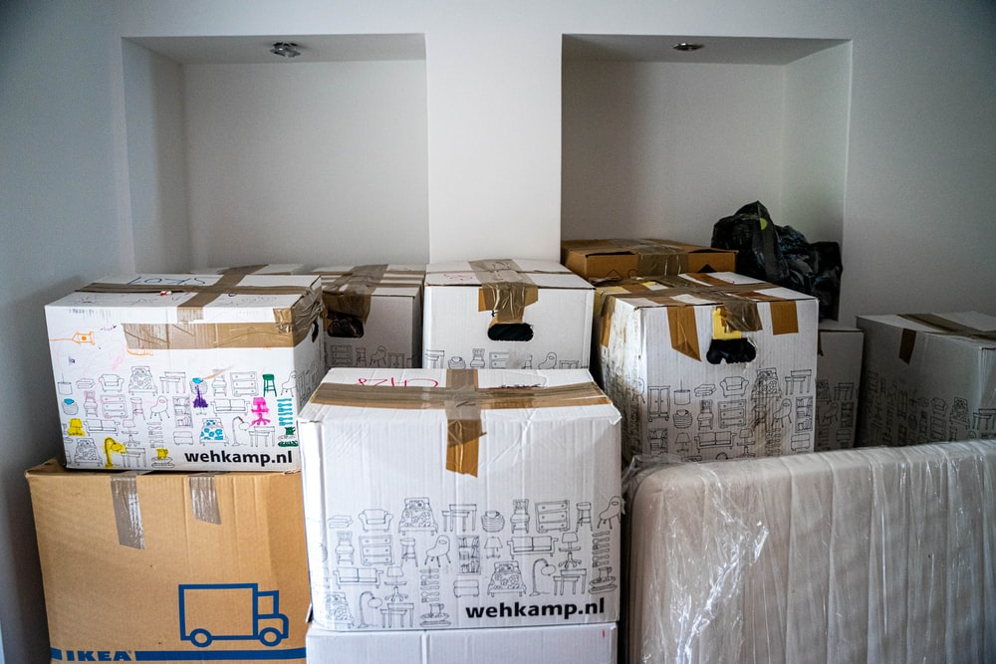

Stress & illness Stress as a stimulus
Limitations of life events measurement:
Many studies supporting links between LCUs & health rely on retrospective reporting
Cultural/regional appropriateness & frequency issues
Entanglement
Life “hassles”?
Ambiguities in items
Assumes consistent interpretation (Dohrenwend et al., 1990)
Assumes consistent responses
Notes:
There are a number of studies that have found associations between these life changing units and ill health.
I looked and there are still many being published in recent years
However, most of those that find stronger associations between LCUs and health tend to rely on retrospective reporting with people who are already ill
We know people have a tendency to search for explanations for their illness, which may result in them misattributing their illness to past events
Prospective designs find much weaker relationships
Items included in the scale are not globally appropriate or common:
Some of the items may not be culturally relevant, particularly some of those around worklife
Some uncommon for people of different ages, including childbirth and marriage
And some are very infrequently experienced by many (e.g., moving house)
Entanglement:
Some of the items may cancel out or enhance the effects of one another
Moving house can be associated with getting married or changing jobs (could be more or less stressful as a result of this combination)
Life hassles:
This only considers major and often rare life events
Overlooks daily hassles that are irritating, frustrating, and demanding:
School tests, money worries, getting kids to school on time
Some evidence to suggest that these are independently associated with negative mental and physical health outcomes, to a greater extent than major life events.
Ambiguities:
Some items aren’t clear
A change in social activities could mean a variety of different things and can be caused by different things (starting rock climbing because you love it vs ending it because you’re injured)
Assumes consistent interpretation:
Relatedly: This approach assumes that all people perceive these events in a similar way
Dohrenwend et al., 1990 asked people who said they experienced each of these events to clarify what actually occurred.
- For some “ deaths of close friends” included the death of long absent, childhood friends to the respondents no longer spoke with; and serious illness and injury range from bouts of flu and sprained arms to severe heart attacks.
A positive response on the same checklist may vary between individuals in terms of the severity of the event.
These sorts of findings have led to some researchers adopting an interview approach where individuals are asked to describe the events, and then an independent interviewer records the severity of the life event.
Assumes consistent responses:
Also presumes people respond to them in a similar way
People are different in terms of their personalities and disposition (big 5, optimism)
People are different in terms of their resources
Moving house or changing job can be stressful depending on the circumstances and individual resources
People are different biologically, genetically, and physically (illness & disability)
This makes using standard LCUs questionable
Clearly, there’s more to stress than the stimulus itself. There is an interaction between person and event that we must consider.
Still, overall, there is substantial evidence that stressful life events, particularly when we experience many of them, have a negative impact on our lives and are associated with greater stress, anxiety, and depression

Slide 9

Stress & illness Stress as an interaction between event & individual
“The mind is its own place and, in itself can make a heaven of hell, a hell of heaven”
John Milton, Paradise Lost
Appraisal is central to whether an event is deemed to be a stressor (Lazarus, 1964)
Cognitive Transactional Model of Stress (Lazarus & Folkman, 1987):
When people confront a new or challenging environment they engage in a process of appraisal
Appraisal comes in two forms
Stress experienced when perceived harm or threat is high and perceived coping ability is low
Appraisals can vary over time
Primary vs. secondary appraisal
Primary appraisal: Evaluation of the stimulus event (harm, threaten, challenge)
E.g., “Is it relevant to me?, “If potentially negative, then does it pose me harm/threat/challenge?”
Secondary appraisal: Evaluation of one’s ability to cope with the stressor
E.g., “How am I going to deal with this?”, “Who can I call on to help me with this?”
Notes:
This brings us to a more psychologically focused new of stress,which I think this quote is a nice introduction to.
Paradise lost: long poem from the 1600s (https://milton.host.dartmouth.edu/reading_room/pl/book_1/text.shtml)
Okay, so in our psychological view of stress, we see it as a transaction, with appraisal or evaluation being central
Lazarus was at the forefront of this way of thinking about stress after performing a study that showed:
people responded differently to a video showing young Australian aboriginal boys going through a rite of passage that included genital mutilation.
People who listen to a narrator over the video who suggested the procedures were not painful or were a normal cultural procedure reported significantly less stress than people who listen to a narrator that emphasised the pain and trauma of individuals being initiated.
This work and other studies led to the development of the Cognitive Transactional Model of Stress
----
[TEXT BOX]
Primary appraisal involves considering the quality and nature of the stimulus event.
There are three kinds of stressor – those that pose harms, those that threaten, and those that set a challenge
A harmful event is one that is already caused harm (loss or failure)
A threat is the expectation of future harm
A challenge results from demands that are appraised as opportunities for personal growth opportunities that a person is confident about dealing with
If the event doesn’t pose harm, threaten or set a challenge, it is considered benign or harmless
Secondary appraisal involves evaluating one’s own resources and abilities to cope the stressor
- Internal (strength, intelligence) or external (social support, money) resources can be considered
----
[BULLETS AGAIN]
Stress definition: in other words, stress results from a mismatch between perceived demands and resources, both of which can change over time

Slide 10
Stress & illness Stress as an interaction between event & individual
Developments in the Transactional Model of Stress to include motivational elements:
Primary appraisal made of:
Motivational relevance
Motivational congruence
Secondary appraisal made of:
Internal/external accountability
Problem-focused coping potential
Emotion-focused coping potential
Future expectancy concerning situational change
“Benign” event
“Stressful” event
Event not perceived as harmful or threatening & high perceived coping
Event perceived as harmful or threatening & high perceived coping
Event not perceived as harmful or threatening & low perceived coping
Event perceived as harmful or threatening & low perceived coping
Notes:
TL: So, as long as the event is not perceived as being threatening or harmful then it is a benign event and we don’t need to be concerned
TR: If the event is perceived as harmful or threatening but the perceived ability to cope (secondary appraisal) is high then we may experience a different state – this is sometimes referred to as positive stress
It may be similar to the idea of eustress proposed in the 1970s by stress researcher Hans Selye – the kind of stress we experience when we participate in sports or performing arts, and where it may actually increase one’s performance)
BR: It’s only concerning when we reach a point where the event is perceived as harmful and/or threatening and our ability to cope is low – negative stress
In the years after its initial development, Lazarus worked with colleagues to add complexity to the model and add elements of emotion in addition to the cognitive components already included
Primary appraisal contains two sequential assessments:
First, one of motivational relevance, or the extent to which the event is considered relevant to one’s current goals or commitments — the extent to which the event is important!
Second, the extent to which the situation is perceived to be congruent with the current goals — the desirability of the event!
So, in relevance to attending this class, the motivational relevance is likely to be high (“attending this class is important to me completing my degree”)
but the motivational congruence might be low (“I’d rather relax at home with my friends or kids”)
Another example could be if I was asked to give a talk at the University on Problem gambling to all of the executive staff.
There should be high motivation relevance, given that if I look like a complete idiot I could lose my job and won’t be able to study this area anymore
But I could be extremely busy and invested in actually doing important research in this space and not very convinced that giving this talk would help me to progress the field -- motivational congruence would be low (obiosuly a made up example)
The updated model contained four secondary appraisal components (which concern one's resources and options for coping with the encounter), and connected appraisals with different emotions:
Internal/external accountability: concerned with attributing responsibility for the event; Why did they stressor occur? Was it because of me or someone else? Involves distinguishing between emotions of anger (blaming others) and guilt (self blame)
Problem- focused coping potential: consider the extent to which this situation is perceived as changeable by coping options (e.g., being problem focused on finding practical solutions); closely linked with hope and optimism or sadness and helplessness depending on perceived ability to change the situation.
Emotion focused coping potential: concerned with perceiving an ability to cope emotionally with the situation. Related to fear and anxiety
Future expectancy concerning situational change: refers to perceived possibilities of the situation being changeable, with perceptions of unchangeability associating with sadness. Can the situation be changed at all, regardless of coping strategies?

Slide 11
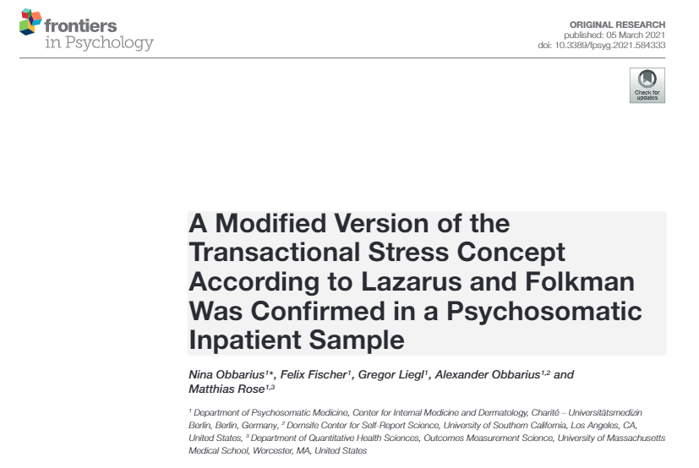
Stress & illness Stress as an interaction between event & individual
Strengths of the Transactional Model of Stress:
Acknowledges individual differences in response
Considers cognitive & emotional components
Highly supported & studied
Limitations of the Transactional Model of Stress:
Risk of circularity
Some events are more inherently “stressful” than others
High stress events
Those that are:
Imminent
Unpredictable
Ambiguous
Undesirable
Outside of one’s control
Life changing
Notes:
Strengths of the Transactional Model of Stress:
a
Acknowledges individual differences in response: accounts for the fact that people respond differently to the same stressor and the important role of appraisal
Considers cognitive and emotional components: in addition to considering the cognitive appraisal component, it also acknowledges how emotional states relates to stress and appraisals
Limitations of the Transactional Model of Stress:
Risk of circularity: there is a risk of tautology as whether a event is perceived as demanding or not depends on perceived coping capacity, and whether coping capacity is perceived as adequate or not is dependent on perceived demand
Not necessary a limitation, but some events are inherently more stressful than others and therefore responses are less the result of differences in appraisal
Imminent: driving test later today; big presentation in 10 minutes
Unpredictable: death of a child or loved one
Ambiguous: in relation to both personal role (e.g., what should I be doing in my new job) and potential risk or harm (e.g., Side effects of a new medication or surgery)
Undesirable: having to move house because of losing one’s job or moving country to be with your parents because they become critically ill
Outside of one’s control: noisy neighbors; family illness
Life changing: any event that causes high amounts of life change (e.g., Having a child; relocation)
However, it still fails to tell us how negative life events influence health outcomes? Which we will start to turn to next

Slide 12
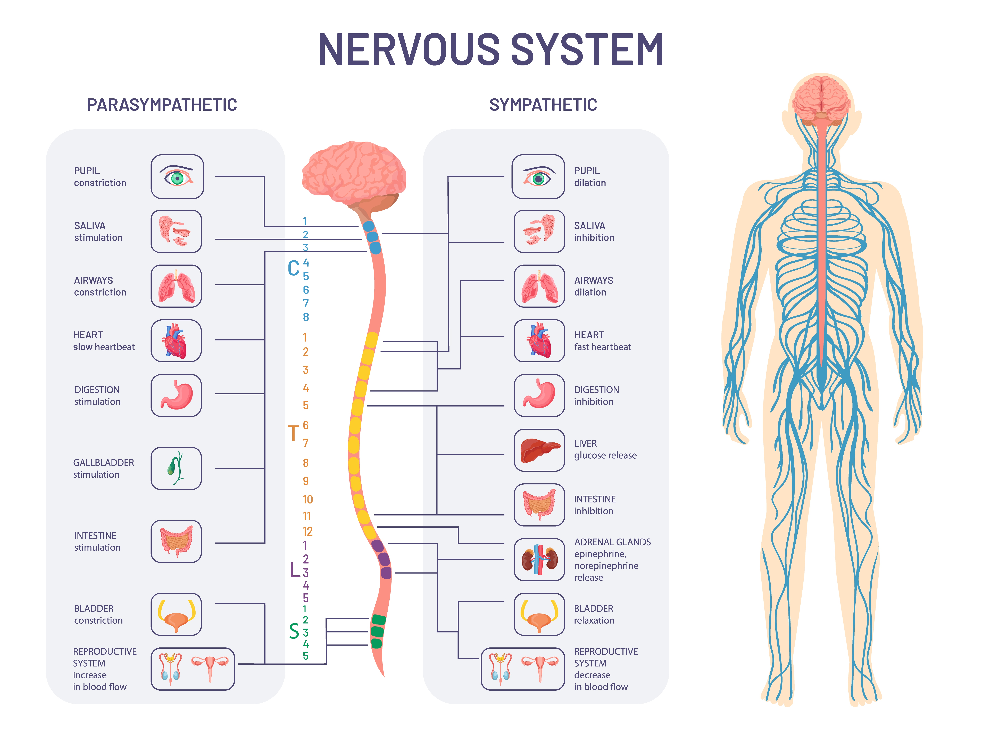
Stress & illness Stress as a physiological response
Nervous system
Central nervous system
Peripheral nervous system
Somatic nervous system
Autonomic nervous system
Parasympathetic division
Sympathetic division
Notes:
We can also consider stress as a physical or biological response, rather than an event or the interaction between event and interpretation
Taking this perspective allows us to better understand HOW stress affects our physical and mental health
But first, in order to understand how stress affects us physiologically we need to have a basic grasp of the human nervous system.
The system can first be divided structurally into the central and peripheral nervous systems
Then it can be divided functionally into the somatic and autonomic nervous systems
The somatic nervous system is primarily responsible for transmitting and processing sensory information and controlling motor movements
The autonomic nervous system is concerned with the regulation of smooth muscle, cardiac muscle, and glands.
The internal functions of our body like salvia production and digestion, energy use.
The parasympathetic nervous system supports activities that are designed to conserve energy and predominates in quiet “rest and digest” conditions
while the sympathetic nervous system drives the “fight or flight” response in stressful situations. Involved with activities that expend energy.

Slide 13
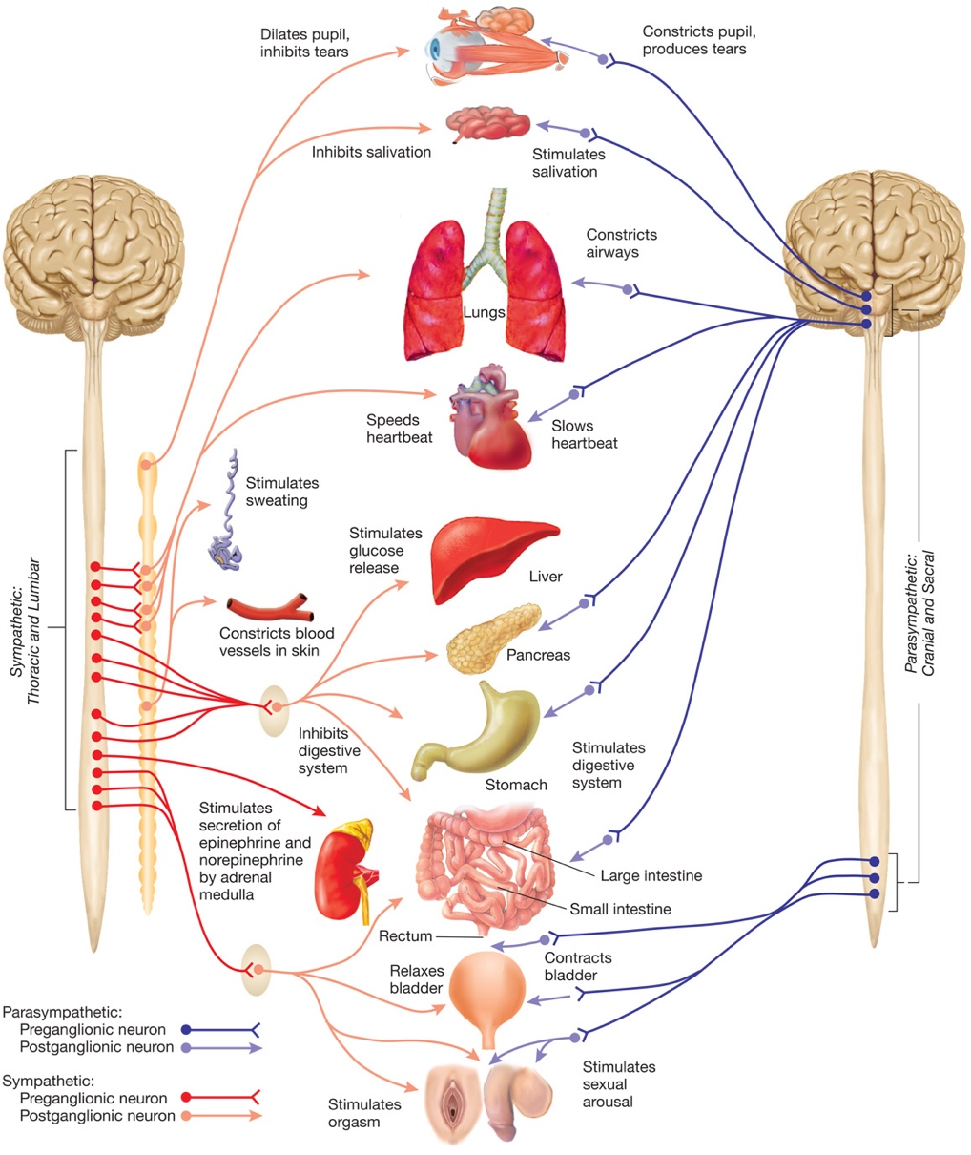
Stress & illness Stress as a physiological response
Sympathetic Adrenal-Medullary (SAM) System
Stressful event
Hypothalamus & sympathetic nervous system stimulate the adrenal medulla
Release catecholamine stress hormones
Notes:
Okay, so how does this link with our stress response?
Well, there are TWO NEUROENDOCRINE, OR HORMONE, PATHWAYS ACTIVATED BY STRESSFUL EVENTS.
The first involves the sympathetic nervous system and ensures a rapid response to a stressful situation
This is what controls what is known as our fight or flight response – we either stand and face the threat or literally or metaphorically run away from it.
Although we have also added freeze and fawn (to literally fawn over or please the potential stressor or aggressor to placate them and minimise the emotional or physical threat)
Talk through diagram
If we look at what the sympathetic nervous systems does, we can see how different functions come together to create this stress response
But how does our parasympathetic nervous system have this affect?
Through a bodily system called the sympathetic adrenal medullary system, or SAM system
This system is activated when we experience a stressful event
Sensory information is sent to the hypothalamus, which sends a signal via the sympathetic nervous system to activate the adrenal medulla [using the neurotransmitter acetylcholine]
The adrenal medulla then releases what are known as catecholamine stress hormones, or adrenaline and noradrenaline (referred to as epinephrine and norepinephrine in the US)
Together, these catecholamine hormones initiate a rapid activation of the sympathetic nervous system
Adrenaline: causes the nutrients stored in muscles to become available to provide energy for strenuous exercise
Along with norepinephrine, it increases blood flow to the muscles by increasing the output of the heart
In doing so, it increases blood pressure (increased circulation and energy availability)
BUT norepinephrine is also a neurotransmitter as well as a hormone and is released into the central nervous system by noradrenergic neurons.
Activates amygdala and subsequently the locus coeruleus
Which is a small bundle of neuronal cell bodies located deep within the brainstem
Its name translates as a blue spot from Latin
Appears to be involved in regulating blood pressure, increasing anxiety like states, and is generally thought to increase cognitive ability to deal with stressors
But returning our focus to the SAM system, the activation of the sympathetic nervous system via this system is short lived and sometimes we need to respond to stressors over an extended period of time
Adrenal medulla: The inner part of the adrenal gland (a small organ on top of each kidney)
Adrenal cortex: The outer part of the adrenal gland (a small organ on top of each kidney).
Catecholamine: defined by their chemical structure

Slide 14
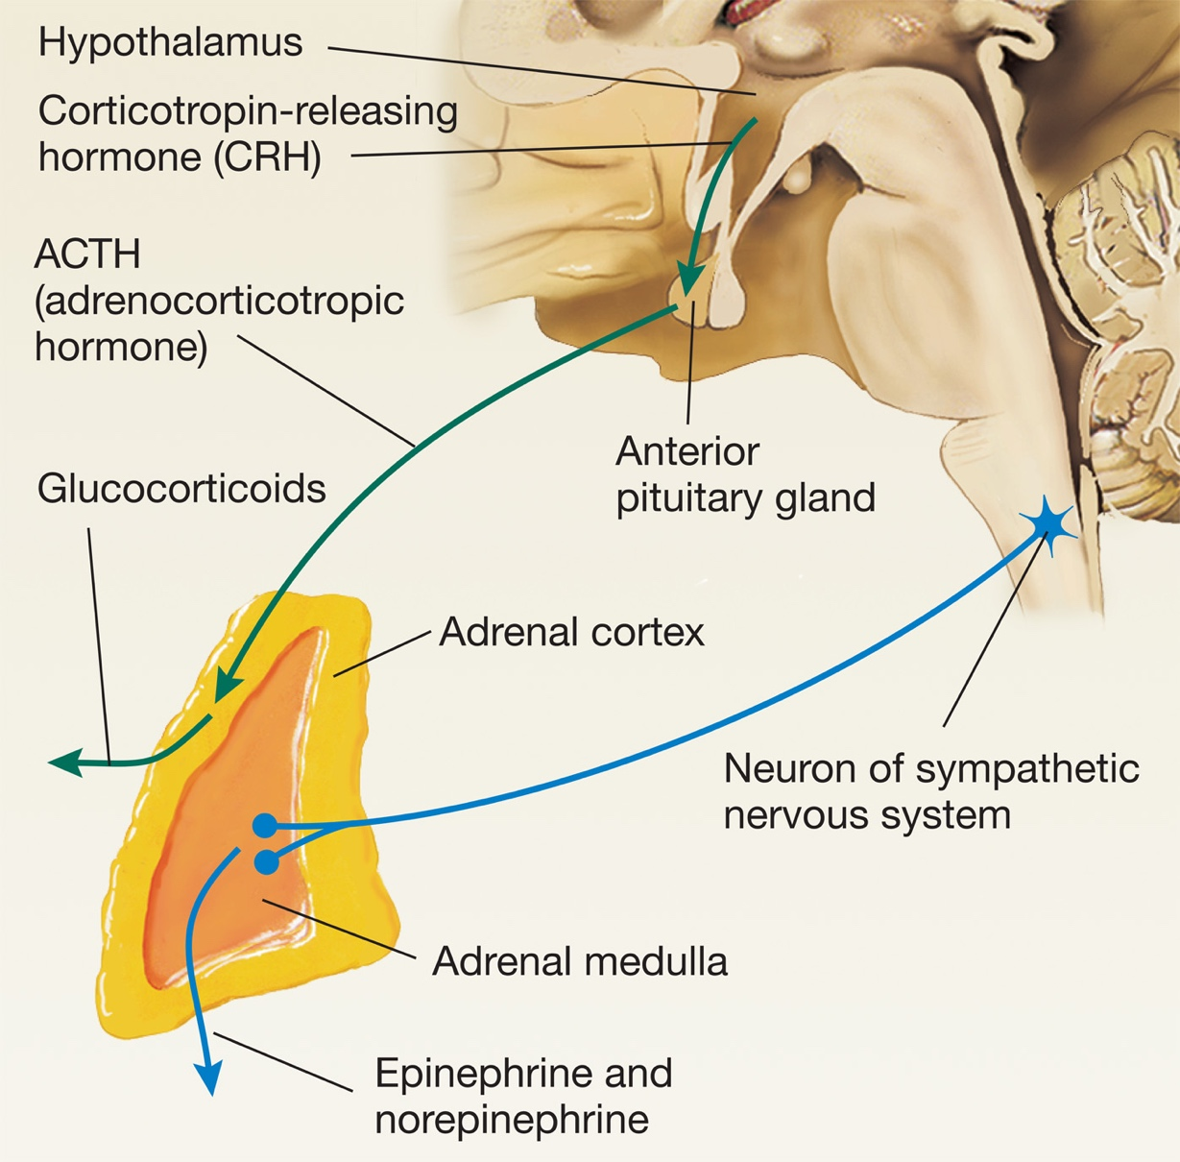

Stress & its effect on our body Stress response
Hypothalamic-Pituitary Adrenocortical (HPA) System
Stressful event
Hypothalamus secretes corticotropin releasing hormone
Regulation of mood in response to stress
Stimulates the anterior pituitary gland to which secretes adrenocorticotropic hormone
Stimulates the adrenal cortex to secrete glucocorticoids
Notes:
SAM SYSTEM IN BLUE
HPA GREEN
this second system, known as the hypothalamic-pituitary adrenocortical system enables our bodily organs to alter their usual function to facilitate a longer lasting adaptive response to stress.
In this system, once an environmental stressor is identified,
Also originates in the hypothalamus
Hypothalamus secretes a peptide called corticotropin releasing hormone (or corticotropin releasing factor; CRF)
This stimulates the anterior pituitary gland to secrete adrenocorticotropic hormone
This enters the general circulation and stimulates the adrenal cortex to secrete glucocorticoids
The primary glucocorticoid secreted is cortisol
It has a huge effect on glucose metabolism and helps to break down fats and proteins so that we can more readily extract energy from them. This is literally why it’s called a GLUCO-corticoid! Because of its substantial effect on glucose metabolism.
Increase the amount of free amino acids in the blood by diverting them away from muscle and to the liver where it converted to glucose
Increase free fatty acids in the blood by mobilising fat from adipose sites. Again, most go into the liver and are converted to glucose
It suppresses immune function by inhibiting the action of white blood cells known as phagocytes (fag-o-cites) and lymphocytes
Blocks calcium from entering the bones and prevents new bone from forming (which is why chronic stress is associated with an increased risk of osteoporosis)
Calcium can then be used for neuronal communication and blood clotting
It increases blood flow
It indirectly suppresses the secretion of this sex steroid hormone
Almost every cell in the body contains glucocorticoid receptors, which means this hormone can affect almost every cell in the body
It aims to prepare the body to deal with a stressful situation for a more prolonged period of time
Green pathway:
Just like with norepinephrine and the SAM system, corticotropin releasing hormone/factor has a number of important functions within the brain in addition to stimulating the anterior pituitary gland to secrete adrenocorticotropic hormone.
It’s thought that this acts as a neurotransmitter in areas of the brain important for emotional regulation, including the limbic system, potentially regulating the emotional response to stress.
Overproduction of corticotropin releasing factor has been associated with depression.
------
Blood cortisol levels are at their peak 20 to 40 minutes after a stressor, and thus the levels have been used as a index of stress in many studies.

Slide 15
Stress & illness Stress & health
 | Stress response system
 | Sympathetic Adrenal-Medullary (SAM) System | Hypothalamic-Pituitary Adrenocortical (HPA) System
Hormones | Catecholamines (adrenaline & noradrenaline) | Glucocorticoids (cortisol)
Intended duration | Fast-acting, short-lived | More sustained response
The duration of the physiological responses to stress influences whether they are beneficial or not
Notes:
Both systems are important for helping our body to maintain it’s homeostatic state (or it’s healthy, normal range of function)
But both systems should only be activated temporarily
It is when they become activated over prolonged periods of time that our physiological reaction distressed starts to become problematic for our health
There are countless examples of people experiencing a highly stressful events and becoming quite unwell after them. Including many cases where people die not to long after their spouse – the widowhood effect
evidence for this is mixed, but some studies find a quite increased risk of death during the first few months after someone’s spouse dies
Anyone have examples of this???
We all sort of know that extended stress it is bad for our health, and so now will turn our attention to why this is the case.

Slide 16
Stress & its effect on our body Stress & health
Wound healing:
Slower wound recovery (Gouin & Kiecolt-Glaser (2011)
Surgery complications:
Increased complications post-operation (Mavros et al., 2011)
The common cold:
Increased risk (Cohen et al. 1991; Takkouche et al., 2001)
COVID-19:
Poorer outcomes (Ramezani, et al. 2020)
Stress & immune function
Glucocorticoids & (to a lesser extent) catecholamines suppress the immune response
High stress levels are associated with (Segerstrom & Miller, 2004):
Decreased lymphocyte proliferation
Decreases in natural killer (NK) cells
Decreased pro-inflammatory cytokines
Lower antibody response to vaccines (Burns et al., 2003)
Notes:
The first way through which extended activation of the SAM or HPA axis past and detrimental impact on health is via suppression of the immune system.
High stress levels are consistently associated with (Segerstrom & Miller, 2004):
Decreased lymphocyte proliferation: A lymphocyte is a type of white blood cell that is made in bone marrow. There are two main types of lymphocytes: B cells and T cells. The function of T cells and B cells is to recognize specific "non-self“ antigens. Lymphocyte proliferation actually refers to a chemical process that occurs when a lymphocyte binds with an antigen
Decreases in natural killer (NK) cells: NK cells are a type of lymphocyte cell best known for killing virally infected cells, and detecting and controlling early signs of cancer. As well as protecting against disease, specialized NK cells are also found in the placenta and may play an important role in pregnancy.
Lower antibody response vaccines: found in response to the influenza vaccine and pneumococcal bacterial vaccine. The antibody response to vaccination is an overall indicator of the quality of person’s immune response
How do these changes manifest?
Wound healing: meta-analytic study of research that has examined the relationship between the time it takes wounds to heal and reported stress levels.
“an average correlation of −.42 between psychological stress and wound healing. This suggests that the relationship between stress and wound repair is not only statistically significant, but also clinically relevant.”
There are some studies that show students who get a wound around exam time have a slower recovery time than students who get the injury mid semester.
- This is likely because cortisol is associated with decreased activity of pro-inflammatory cytokines which facilitate wound healing.
Surgery complications: High stress levels, as well as intra-marital conflict was associated with an increased risk of complications post surgery, including inflammation and infection. Dispositional optimism had the opposite effect
Common cold: studies have found that stress levels are associated with an increased risk of experiencing illness when infected with the common cold, in a dose-dependent manner and independent of various demographic and psychological characteristics like personality.
“Psychological stress was associated in a dose-response manner with an increased risk of acute infectious respiratory illness”
Other studies have shown that when you give someone a nasal drop containing the cold virus, they are much more likely to develop an actual cold if they report high levels of current stress or have recently experienced highly stressful events (pg. 577 of textbook)
COVID-19: initial research that seems to suggest that increased cortisol levels are associated with a higher risk of death, but the only studies I found use small samples and there is some extreme risk of confounding – it seems like those who went on to die would have had higher cortisol levels!
There are also a number of other effects of prolonged stress on physical health beyond the immediate effects on immune function, including
elevated blood pressure which increases the risk of heart attacks and strokes – but could also be due to health behaviours associated with stress like poor sleep and smoking, which we’ll talk about in a moment
and stunting in children (see notes in Notion)

Slide 17
Stress & illness Stress & health
Behavioural response to stress
Personality type
Use of services
Elevated stress
Direct physiological changes
Poor health outcomes
Notes:
So, there are different theories regarding the ways in which stress impacts our health
We just talked about the first: the direct route.
Stress produces physiological changes that lead to the development of illnesses, particularly when the stress is chronic
There are also indirect theories that have been proposed
Behavioural response to stress: people, by virtue of their behavioural response to stress, such as smoking, eating habits and drinking, predispose themselves to disease
People with certain personality traits predispose themselves to disease by the manner in which they respond to stress. Neuroticism is particularly associated with a negative response to stress and interpreting any changes in homeostasis as potentially reflecting disease or disorder. There are also more likely to exaggerate the effects of symptoms
People experiencing stress are more likely to use health services than people who aren’t. There are also more likely to be experiencing anxiety, fatigue and insomnia and therefore seek treatment for these symptoms which are not themselves illnesses.
Final arrow: I’ve added this after the lecture after discussing Psycho-onocology (PSY365) and how a large proportion of people with cancer report high levels of distress

Slide 18
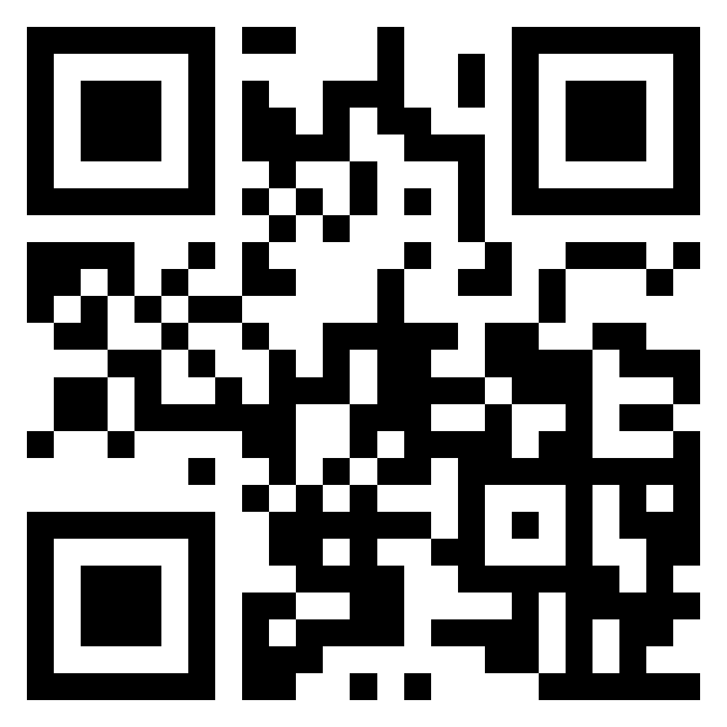
Stress & illness Interactive Task
Please go to the following site & enter this number:
4132 2041
How do you cope with stress?
Log on to Menti and add your thoughts and strategies
Let’s share our experiences and later we’ll see how these compare with what psychological research & theory says about coping strategies and styles
https://www.menti.com/

Slide 19
Block 2 Coping & illness moderators

Slide 20
Coping & illness moderators What is coping?
What is it?
Anything a person does to reduce the impact of the perceived or actual stressor
A volitional effort to alter a stressor or how it’s interpreted
Adaptive coping:
Adaptive coping increases our functioning and decreases the perceived level of stress
Maladaptive coping temporarily decreases the perceived level of stress but may ultimately make it worse. May also de
Problem-focused coping
Attention/approach, monitoring, vigilant, active
Coping efforts directed at the stressor in order to reduce the demands of it or increase one’s resources
Efforts concerned with attending to the source of the stress and trying to deal with the problem
Emotion-focused coping
Avoidant, blunting, passive
Coping efforts directed at managing the emotional response to the stressor
Efforts concerned with avoiding or minimizing the threat of the stressor
Notes:
Anything a person does to reduce the impact of the perceived or actual stressor
A volitional effort to alter the stressor or how it’s interpreted: It’s volitional or purposeful because we are trying to achieve adaptation, and our coping styles are constantly changing and can be learned from past experiences
May not directly target the stressor but it can manage the response to it, through reappraising it or minimizing it (“I can’t buy a car but at least I’ll get fit walking everywhere”;
- alternatively, coping can help reduce stress indirectly, say through exercising when you have an important exam coming up.
Broadly divided into four types:
Problem focused coping:
This could include things like planning how to change the stressor or how to behave in order to control it
Suppressing competing activities so they can focus on ways of dealing with the stressor
Seeking practical information support
Confronting the source of the stress
Emotion focused coping:
Positively reappraising the stressor in order to see attaining a more positive light
Accepting the stressor
Seeking emotional support
Venting anger
Prayer
Attentional approach:
Seeking information about it – e.g., watching the news when we’re stressed about covid to stay up to date with the latest developments
Making active cognitive or behavioural efforts to manage the stressor
Avoidant:
Distracting oneself by thinking of pleasant thoughts
Avoiding the situation
Disengagement through substance misuse (self-medicating)
Adaptive coping tends to be problem focused, although it certainly can be emotion focused, and involves attention directed at the stressor.
Maladaptive coping tends to be emotion focused and diverts attention away from the stressor.
however, it’s important to note that avoidant coping can sometimes be positive.
In the text it gives an example of a study that found is denial among patients with lung cancer was protective of quality-of-life and positive mood
People with high levels of denial report bettersocial outcomes and less anxiety and depression
In the context of disease and poor prognosis, denial may be adaptive

Slide 21





Coping & illness moderators Personality
Big-5 and stress
Neuroticism
high levels of neuroticism are typically associated with high levels of perceived distress, cortisol levels & depression (Banjongrewadee et al., 2020; Hudek-Knežević & Kardum, 2009; O’Súilleabháin et al., 2020)
Conscientiousness
Associated with reduced cortisol levels and increased longevity (Bogg & Roberts, 2004; Hill et al., 2011; Steptoe et al., 2017)
Neuroticism
Emotional stability
Neurotic
Extroversion
Introversion
Extraversion
Openness
Closed
Open
Agreeableness
Hostile
Agreeable
Conscientiousness
Spontaneous
Conscientious
Notes:
The Big Five personality traits, are a widely accepted framework for describing personality.
The history of the Big Five can be traced back to the 1930s, when a number of researchers began developing personality tests based on factor analysis, a statistical technique for identifying underlying dimensions in large sets of data. Over the years, different researchers proposed various sets of personality dimensions, but by the 1980s, there was a growing consensus around the Big Five.
Lewis Goldberg, in 1990, proposed a model that included the five traits we know today. Since then, the Big Five has been widely studied and validated, with a large body of research showing that the five traits are robust across cultures, ages, and other demographic factors.
Neuroticism: high tendency to experience negative emotions like anxiety and worry, and a pessimistic outlook.
- It’s thought that this link could be associated with a combination of increased use of healthcare services; as well as a lower-threshold for considering events stressful and increased physical stress response to events and therefore the resulting negative health effects.
Hudek-Knežević & Kardum, 2009: neuroticism is consistently a stronger predictor of health outcomes than the other BIG-5 dimensions
Conscientiousness: Associated with increased health protective behaviours like exercise and healthy diet and reduction in risky health-related behaviours
From Bogg & Roberts 2004 : “The resulting database contained 194 studies that were quantitatively synthesized. Results showed that conscientiousness-related traits were negatively related to all risky health-related behaviors and positively related to all beneficial health-related behaviors. ”
Need to add the link with cortisol levels from page 416 of the textbook!!

Slide 22

Coping & illness moderators Personality
Personality types and stress
Type A
- competitiveness, impatient, easily annoyed, achievement orientated.
Type B
- relaxed, non-urgent, non-competitive, agreeable
Type C
- Supression of emotion (stoic), non-expressive, poor stress coping leading to hopelessness
Type D
- Distressed personality: low mood, poor outlook, social inhibition
Notes:
Type A – they’re time urgent (lots to do).
- Type A behaviour and emotional pattern has shown a moderate link with CHD as compared to Type B behaviour.
however, research has shown mixed findings so it’s unclear whether this categorisation has nay real value
More recently, it’s been suggested that hostility and anger aspects of type-A personality are the only real solid predictors of stress and negative health outcomes, so it’s better to just focus on these
Type C
There have also been attempts to find a personality linked with the onset of cancer, motivated by the Type-A CHD link.
The suggested profile was… [describe]
However, studies have found these traits are not predictive of cancer onset or outcomes.
Type D: Social inhibition: avoidance of potential dangers involevd in social interaction such as disapproval or non-reward by others.
Again, some connection with CHD, but findings inconsistent
Why doesn’t research consistently link personality types to health outcomes?
Many other moderating factors
Value of categories questionable

Slide 23
Coping & illness moderators Personality
Brief Stress Questionnaire
1. In the last month, how often have you felt that you were unable to control the important things in your life?
2. In the last month, how often have you felt confident about your ability to handle your personal problems?
3. In the last month, how often have you felt that things were going your way?
4. In the last month, how often have you felt difficulties were piling up so high that you could not overcome them?
Item | Score
The next question deals with optimism. Optimists are people who look to the future with confidence and who mostly expect good things to happen. How would you describe yourself? How optimistic are you in general? | Where would you place yourself on a scale from 1 (not at all optimistic) to 7 (very optimistic)?
2. The next question is about pessimism. Pessimists are people who are full of doubt when they look to the future and who mostly expect bad things to happen. How would you describe yourself? How pessimistic are you in general? | Where would you place yourself on a scale from 1 (very pessimistic) to 7 (not at all pessimistic)?
0 = Never
1 = Almost Never
2 = Sometimes
3 = Fairly Often
4 = Very Often
Reverse score items 2 & 3: (e.g., 0 = 4, 1 = 3, 2 = 2, 3 = 1 & 4 = 0)
Notes:
Sum and average your optimism score
Stress measure:
https://www.sprc.org/system/files/private/event-training/Penn%20College%20-%20Perceived%20Stress%20Scale.pdf
Optimism measure:
https://measurementinstrumentssocialscience.biomedcentral.com/articles/10.1186/s42409-021-00027-6

Slide 24
Stress & illness Interactive Task
Please go to the following site & enter this number:
4132 2041
Is optimism associated with stress among us?
Jot down your scores
Log on to Menti and add your scores in response to the questions
Let’s compare our outcomes with what psychological research…
https://www.menti.com/

Slide 25

Coping & illness moderators Personality
Optimism
Dispositional optimism: having a generally stable positive outlook on life and positive outcome expectations
Associated with a reduction in the incidence of coronary heart disease, all-cause mortality, stroke, re-hospitalization following heart surgery, and the negative life impact of cancer (Avvenuti et al., 2016).
Associated with better social & mental functioning among those with chronic illnesses (Colby & Shifren, 2013)
Reduced smoking rates, more walking and physical exercise, and moderate alcohol consumption (Steptoe et al., 2006)
Notes:
Again, optimism associated with health enhancing behaviours like social engagement and exercise
Colby, D. A. & Shifren, K. (2013):

Slide 26
Coping & illness moderators Locus of control
A trait-like expectation that one’s actions will be effective in controlling or mastering the environment
Health locus of control (HLoC): the belief that health is in one’s control
High internal LoC has been associated with:
Self-reported health among people at risk for cardiovascular disease (Berglund et al., 2014)
Improved treatment outcomes (Zuercher-Huerlimann et al., 2019)
Self-reported health, fewer physical or mental health conditions, decreased use of healthcare (Kesavayuth et al., 2020)
Locus of control
Internal
External
Notes:
Individuals can fall on the side of internality or externality.
People with an externally focused locus of control tend to attribute their behaviours and outcomes to chance or luck.
I only passed that test because the teacher is really nice and made the test easy
By contrast, people who are internally focused tend to attribute their behaviours and outcomes to their own efforts
I passed that test because I worked my butt off revising for it!
Locus of control is associated with a variety of different health outcomes
The concept of health locus of control is being developed specifically to focus on people’s sense of control over their own health
Berglund et al (2014): 414 Swedish patients who were using statins completed a questionnaire about their health,
“High internal health locus of control was negatively associated with the cumulative burden of diseases, while health locus of control in chance and powerful others were positively associated with burden of diseases.”
Zuercher-Huerlimann et al. (2019): this study involved 225 patients with a chronic pain condition from Switzerland
They measured pain intensity pre-and post a treatment
A higher internal health locus of control that pre-treatment was associated with a greater reduction in pain intensity at post-treatment
Kesavayuth et al. (2020): data comes from the Household Income and Labour dynamics of Australia (HILDA) study from 2002 to 2017
Ultimately used data from over 16,000 individuals
Asked people about how they feel about their health
Objective questions relating to physical and mental health disorders
Asked people about the use of healthcare, including curative (e.g., doctors visits and hospital stays) and preventative (e.g., Health checkups) healthcare used.
“We find that locus of control is significantly related to health and healthcare use. Men and women with an internal locus of control have better self-assessed health, physical and mental health. They rely less on healthcare, both preventive and curative.”
“Those with an internal locus of control invest more in healthy behaviors and social capital, which positively influences their health.”

Slide 27
Coping & illness moderators Social support
Types & functions of social support | Types & functions of social support
 | “Provider” offers | “Recipient” receives/benefit
Emotional support | Empathy, care, or concern | Reassurance, sense of comfort and belonging
Esteem support | Positive regard, encouragement, positive comparisons | Builds self-worth, sense of confidence, feeling valued
Tangible/ practical support | Direct assistance | Reduces strain
Informational support | Advice, suggestions, feedback | Self-worth, self-efficacy
Network support | Welcoming Shared experiences | Sense of belonging Affiliation
Actual or perceived support from others
Social support can come from a variety of sources:
Friends, partners, family, colleagues, health and social care professionals, support groups
Yamagata Study
Feeling like you have someone available to take you to the hospital associated with reduction in all-cause mortality (Uzuki et al., 2020)
Notes:
So far, we’ve focused on individual factors that relate to coping and illness moderation
There are also factors beyond the individual
We tend to think of social support as just coming from close friends and family, but it can come from a variety of different individuals or groups – teachers, mentors, classmates.
Social support tends to change with age, with fewer non-kin relationships as we get older and more focus on family relationships (states this in textbook and supported by studies I’ve found)
Social support is not a single, unitary concept
Can come in a variety of forms
You get different types of social support from different individuals or groups
Yamagata Study
They studied over 16,000 Japanese people
They asked the following questions
Do you have someone:
whom you can consult when you are in trouble?
whom you can consult when your physical condition is not good?
who can help you with daily homework?
who can take you to hospital when you don’t feel well? and
who can take care of you when you are ill in bed?
Only no. 4 predictive of all-cause mortality:
- they suggested this may indirectly affect health as its associated with living alone
- and more direct factors are also important: poor prognosis for later arrival after cardiovascular disease episodes

Slide 28
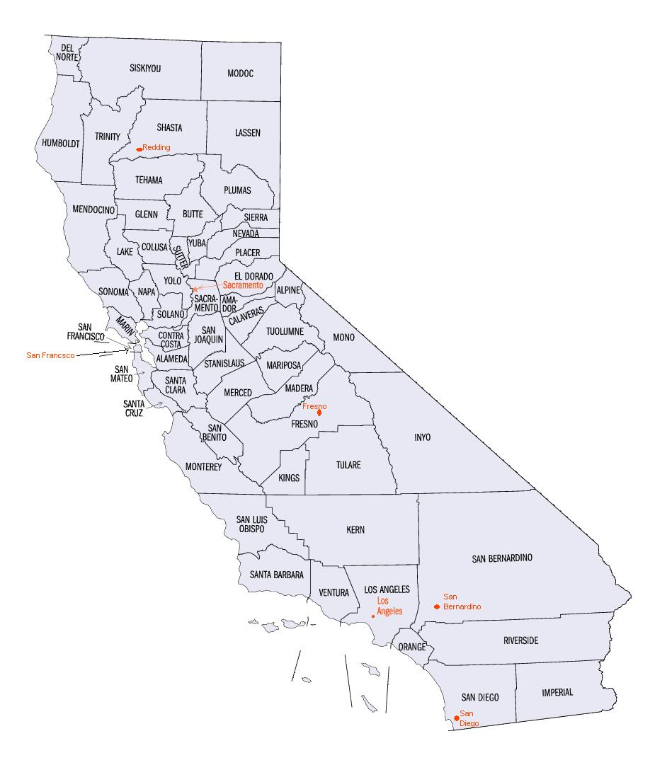
Coping & illness moderators Social support
Relationship between social support and stress:
Greater social support is consistently associated with lower stress levels (Qi et al., 2020; Woodhead et al., 2014)
Massive meta-analysis of social support & health (Vila, 2021):
1,187 studies with 1.46 million participants show a strong link between social support and reduced disease and mortality
How does social support affect health?
Direct effect hypothesis: Social support directly benefits our health irrespective of stress levels
Buffering hypothesis: Social support protects against the negative physiological effects of stress
The “Alameda County Study” (Berkman & Syme, 1979)
More than twofold increase in the risk of mortality for those with the fewest social ties
Image source: Wiki Commons
Notes:
Similar picture here emerges to internal locus of control:
- Associated with a range of positive health outcomes
Relationship between support and stress:
Recent evidence to suggest that the mental health impacts of COVID-19 and the lockdown were mediated by social support
Those with more social support were less likely to experience mental health problems
Alameda seven study: Followed nearly 7000 adults in Alameda County from 1965 to 1999 – very famous study on the link between health and behaviour (papers till being published on the data today!)
A follow-up at nine years found the people had the fewest social and community ties were more likely to die in the follow-up period
More than a twofold increase in the risk of mortality for those with the fewest social ties
This was independent of physical health, health behaviours like smoking, alcohol consumption and exercise
How does social support affect health?
Direct effect hypothesis: high social support provides greater ties to other and a greater sense of belonging and self esteem than low levels
This leads to a more positive outlook and healthier lifestyle
People are more likely to engaging sports and exercise and less likely to smoke
Buffering hypothesis: social support acts as a buffer by either:
Influencing the person’s cognitive appraisals of the situation so they perceive the resources as being greater to meet the threats
Changing a person’s coping response to a stressor after it has been appraised as stressful
Considerations
Social support measures via self report and likely to to be affected by factors ike neuroticism and optimism, which could increase one’s sense of social support and it’s value

Slide 29


Coping & illness moderators
Cross-cultural differences
Stress and distress in Indigenous Australians
In 2006 the number of Aboriginal & Torres Strait Islander adults with a high distress score was 3 times more than non-indigenous adults (McNamara, 2018)
In 2012-13, 30% of Aboriginal & Torres Strait Islander adults were assessed as having high levels of psychological distress (2.7. times more than non-indigenous adults; AIHW, 2015)
Worldwide differences in stress?
Click here!
Notes:
Stress responses are normal reactions to environmental or internal perturbations and can be considered adaptive in nature. Distress occurs when stress is severe, prolonged, or both.
Some just consider distress the negative form, as opposed to eustress
Higher distress in these groups associated with increased physical disability and illness in first study.

Slide 30
Coping & illness moderators Interactive task
Please go to the following site & enter this number:
4132 2041
Do collectivist and individualist societies differ in the level of stress?
Why?
Scan the literature on this topic
Login to Menti and add your findings and suggestions
Class discussion
https://www.menti.com/
Notes:
Could use this as an activity next year: https://www.ncbi.nlm.nih.gov/books/NBK64942/table/A61041/
Get them to fill out what types of interventions might be useful at each stage!
Evidence that people from Asian collectivist cultures are less likely to seek support at times of stress as they don’t feel like it’s appropriate to burden their friends with their problems
Simplicity of this dichotomy: collectivist vs individualist
“it promotes the mistaken assumption that individualistic and collective values each form coherent syndromes that are in polar opposition.”
See 1990 article: https://journals.sagepub.com/doi/10.1177/0022022190212001vist vs individualistic

Slide 31

Summary: Factors affecting stress
(Some of) the things we know that moderate the effects of stress:
Coping style
Personality
Social support
Locus of control
Culture

Slide 32
Credits & Sources
Where possible, I have included a link to the source for all images used in this slideshow. If an image in this slideshow does not have a link to the source posted below it, then I have either:
Taken it from the site www.unsplash.com and clicking the image will take you to the original source on unsplash.
OR
Used images directly from the Carlson & Brickett (2017) textbook resources provided by the publisher

Slide 33
Next week: Diet & weight management

Slide 34
References
Australian Institute of Health and Welfare (AIHW) (2015). The health and welfare of Australia’s Aboriginal and Torres Strait Islander peoples: 2015. https://www.aihw.gov.au/reports/indigenous-health-welfare/indigenous-health-welfare-2015/contents/determinants-of-health-key-points
Avvenuti, G., Baiardini, I. & Giardini, A. (2016). Optimism’s Explicative Role for Chronic Diseases. Frontiers in Psychology, 7, 295. https://doi.org/10.3389/fpsyg.2016.00295
Banjongrewadee, M., Wongpakaran, N., Wongpakaran, T., Pipanmekaporn, T., Punjasawadwong, Y. & Mueankwan, S. (2020). The role of perceived stress and cognitive function on the relationship between neuroticism and depression among the elderly: a structural equation model approach. BMC Psychiatry, 20(1), 25. https://doi.org/10.1186/s12888-020-2440-9
Berglund, E., Lytsy, P. & Westerling, R. (2014). The influence of locus of control on self-rated health in context of chronic disease: a structural equation modeling approach in a cross sectional study. BMC Public Health, 14(1), 492–492. https://doi.org/10.1186/1471-2458-14-492

Slide 35
References
Berkman, l. f. & Syme, S. L. (1979). SOCIAL NETWORKS, HOST RESISTANCE, AND MORTALITY: A NINE-YEAR FOLLOW-UP STUDY OF ALAMEDA COUNTY RESIDENTS. American Journal of Epidemiology, 109(2), 186–204. https://doi.org/10.1093/oxfordjournals.aje.a112674
Bogg, T. & Roberts, B. W. (2004). Conscientiousness and Health-Related Behaviors: A Meta-Analysis of the Leading Behavioral Contributors to Mortality. Psychological Bulletin, 130(6), 887–919. https://doi.org/10.1037/0033-2909.130.6.887
Burns, V. E., Carroll, D., Drayson, M., Whitham, M., & Ring, C. (2003). Life events, perceived stress and antibody response to influenza vaccination in young, healthy adults. Journal of Psychosomatic Research, 55(6), 569–572. https://doi.org/10.1016/S0022-3999(03)00073-4
Cohen, S., Tyrrell, D. A. J. & Smith, A. P. (1991). Psychological Stress and Susceptibility to the Common Cold. The New England Journal of Medicine, 325(9), 606–612. https://doi.org/10.1056/nejm199108293250903
Colby, D. A. & Shifren, K. (2013). Optimism, mental health, and quality of life: A study among breast cancer patients. Psychology, Health & Medicine, 18(1), 10–20. https://doi.org/10.1080/13548506.2012.686619
Dohrenwend, B. P., Link, B. G., Kern, R., Shrout, P. E., & Markowitz, J. (1990). Measuring life events: The problem of variability within event categories. Stress Medicine, 6(3), 179–187. https://doi.org/10.1002/smi.2460060303

Slide 36
References
Gouin, J.-P. & Kiecolt-Glaser, J. K. (2011). The Impact of Psychological Stress on Wound Healing: Methods and Mechanisms. Immunology and Allergy Clinics of North America, 31(1), 81–93. https://doi.org/10.1016/j.iac.2010.09.010
Hill, P. L., Turiano, N. A., Hurd, M. D., Mroczek, D. K. & Roberts, B. W. (2011). Conscientiousness and Longevity: An Examination of Possible Mediators. Health Psychology, 30(5), 536–541. https://doi.org/10.1037/a0023859
Holmes, T. H. & Rahe, R. H. (1967). The social readjustment rating scale. Journal of Psychosomatic Research, 11(2), 213–218. https://doi.org/10.1016/0022-3999(67)90010-4
Hudek-Knežević, J. & Kardum, I. (2009). Five-factor Personality Dimensions and 3 Health-related Personality Constructs as Predictors of Health. Croatian Medical Journal, 50(4), 394–402. https://doi.org/10.3325/cmj.2009.50.394
Kesavayuth, D., Poyago-Theotoky, J., Tran, D. B. & Zikos, V. (2020). Locus of control, health and healthcare utilization. Economic Modelling, 86, 227–238. https://doi.org/10.1016/j.econmod.2019.06.014

Slide 37
References
Lazarus, R. S. & Folkman, S. (1987). Transactional theory and research on emotions and coping. European Journal of Personality, 1(3), 141–169. https://doi.org/10.1002/per.2410010304
Mavros, M. N., Athanasiou, S., Gkegkes, I. D., Polyzos, K. A., Peppas, G. & Falagas, M. E. (2011). Do Psychological Variables Affect Early Surgical Recovery? PLoS ONE, 6(5), e20306. https://doi.org/10.1371/journal.pone.0020306
McNamara, B. J., Banks, E., Gubhaju, L., Joshy, G., Williamson, A., Raphael, B. & Eades, S. (2018). Factors relating to high psychological distress in Indigenous Australians and their contribution to Indigenous–non-Indigenous disparities. Australian and New Zealand Journal of Public Health, 42(2), 145–152. https://doi.org/10.1111/1753-6405.12766
Nießen, D., Groskurth, K., Kemper, C. J., Rammstedt, B. & Lechner, C. M. (2022). The Optimism–Pessimism Short Scale–2 (SOP2): a comprehensive validation of the English-language adaptation. Measurement Instruments for the Social Sciences, 4(1), 1. https://doi.org/10.1186/s42409-021-00027-6
Obbarius, N., Fischer, F., Liegl, G., Obbarius, A. & Rose, M. (2021). A Modified Version of the Transactional Stress Concept According to Lazarus and Folkman Was Confirmed in a Psychosomatic Inpatient Sample. Frontiers in Psychology, 12, 584333. https://doi.org/10.3389/fpsyg.2021.584333

Slide 38
References
O’Súilleabháin, P. S. & Hughes, B. M. (2018). Neuroticism predicts all-cause mortality over 19-years: The moderating effects on functional status, and the angiotensin-converting enzyme. Journal of Psychosomatic Research, 110, 32–37. https://doi.org/10.1016/j.jpsychores.2018.04.013
Qi, M., Zhou, S.-J., Guo, Z.-C., Zhang, L.-G., Min, H.-J., Li, X.-M. & Chen, J.-X. (2020). The Effect of Social Support on Mental Health in Chinese Adolescents During the Outbreak of COVID-19. Journal of Adolescent Health, 67(4), 514–518. https://doi.org/10.1016/j.jadohealth.2020.07.001
Ramezani, M., Simani, L., Karimialavijeh, E., Rezaei, O., Hajiesmaeili, M. & Pakdaman, H. (2020). The Role of Anxiety and Cortisol in Outcomes of Patients With Covid-19. Basic and Clinical Neuroscience, 11(2), 179–184. https://doi.org/10.32598/bcn.11.covid19.1168.2
Segerstrom, S. C. & Miller, G. E. (2004). Psychological Stress and the Human Immune System: A Meta-Analytic Study of 30 Years of Inquiry. Psychological Bulletin, 130(4), 601–630. https://doi.org/10.1037/0033-2909.130.4.601
Steptoe, A., Easterlin, E. & Kirschbaum, C. (2017). Conscientiousness, hair cortisol concentration, and health behaviour in older men and women. Psychoneuroendocrinology, 86, 122–127. https://doi.org/10.1016/j.psyneuen.2017.09.016

Slide 39
References
Steptoe, A., Wright, C., Kunz-Ebrecht, S. R. & Iliffe, S. (2006). Dispositional optimism and health behaviour in community-dwelling older people: Associations with healthy ageing. British Journal of Health Psychology, 11(1), 71–84. https://doi.org/10.1348/135910705x42850
Takkouche, B., Regueira, C. & Gestal-Otero, J. J. (2001). A Cohort Study of Stress and the Common Cold. Epidemiology, 12(3), 345–349. https://doi.org/10.1097/00001648-200105000-00015
Uzuki, T., Konta, T., Saito, R., Sho, R., Osaki, T., Souri, M., Watanabe, M., Ishizawa, K., Yamashita, H., Ueno, Y. & Kayama, T. (2020). Relationship between social support status and mortality in a community-based population: a prospective observational study (Yamagata study). BMC Public Health, 20(1), 1630. https://doi.org/10.1186/s12889-020-09752-9
Vila, J. (2021). Social Support and Longevity: Meta-Analysis-Based Evidence and Psychobiological Mechanisms. Frontiers in Psychology, 12, 717164. https://doi.org/10.3389/fpsyg.2021.717164
Woodhead, E. L., Northrop, L. & Edelstein, B. (2014). Stress, Social Support, and Burnout Among Long-Term Care Nursing Staff. Journal of Applied Gerontology, 35(1), 84–105. https://doi.org/10.1177/0733464814542465

Slide 40
References
Zuercher-Huerlimann, E., Stewart, J. A., Egloff, N., Känel, R. von, Studer, M. & Holtforth, M. grosse. (2019). Internal health locus of control as a predictor of pain reduction in multidisciplinary inpatient treatment for chronic pain: a retrospective study. Journal of Pain Research, 12, 2095–2099. https://doi.org/10.2147/jpr.s189442

